Slide 1
Object Oriented Design and UML

Slide 2
OO Concepts
Information hiding – use encapsulation to restrict external visibility
OO encapsulates the data, provides limited access, visibility
Info hiding can be provided without OO – is an old concept

Slide 3
OO Concepts…
State retention – fns, procedures do not retain state; an object is aware of its past and maintains state
Identity – each object can be identified and treated as a distinct entity
Behavior – state and services together define the behavior of an object, or how an object responds

Slide 4
OO Concepts..
Messages – through which a sender obj conveys to a target obj a request
For requesting O1 must have – a handle for O2, name of the op, info on ops that O2 requires
General format O2.method(args)

Slide 5
OO Concepts..
Classes – a class is a stencil from which objects are created; defines the structure and services. A class has
An interface which defines which parts of an object can be accessed from outside
Body that implements the operations
Instance variables to hold object state
Objects and classes are different; class is a type, object is an instance
State and identity is of objects

Slide 6
Relationship among objects
An object has some capability – for other services it interacts with other objects
Some different ways for interaction:
Supplier object is global to client
Supplier obj is a parm to some op of the client
Supplier obj is part of the client obj
Supplier obj is locally declared in some op
Relationship can be either aggregation (whole-part relationship), or just client server relationship

Slide 7
Inheritance
Inheritance is unique to OO and not there in function-oriented languages/models
Inheritance by class B from class A is the facility by which B implicitly gets the attributes and ops of A as part of itself
Attributes and methods of A are reused by B
When B inherits from A, B is the subclass or derived class and A is the base class or superclass

Slide 8
Inheritance..
A subclass B generally has a derived part (inherited from A) and an incremental part (is new)
Hence, B needs to define only the incremental part
Creates an “is-a” relationship – objects of type B are also objects of type A

Slide 9
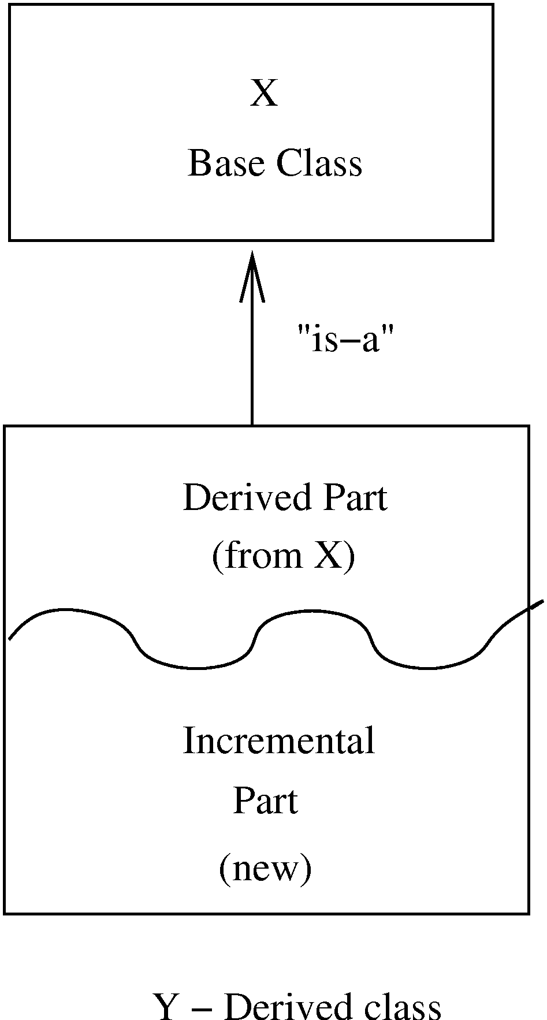
Inheritance…

Slide 10
Inheritance…
The inheritance relationship between classes forms a class hierarchy
In models, hierarchy should represent the natural relationships present in the problem domain
In a hierarchy, all the common features can be accumulated in a superclass
An existing class can be a specialization of an existing general class – is also called generalization-specialization relationships

Slide 11
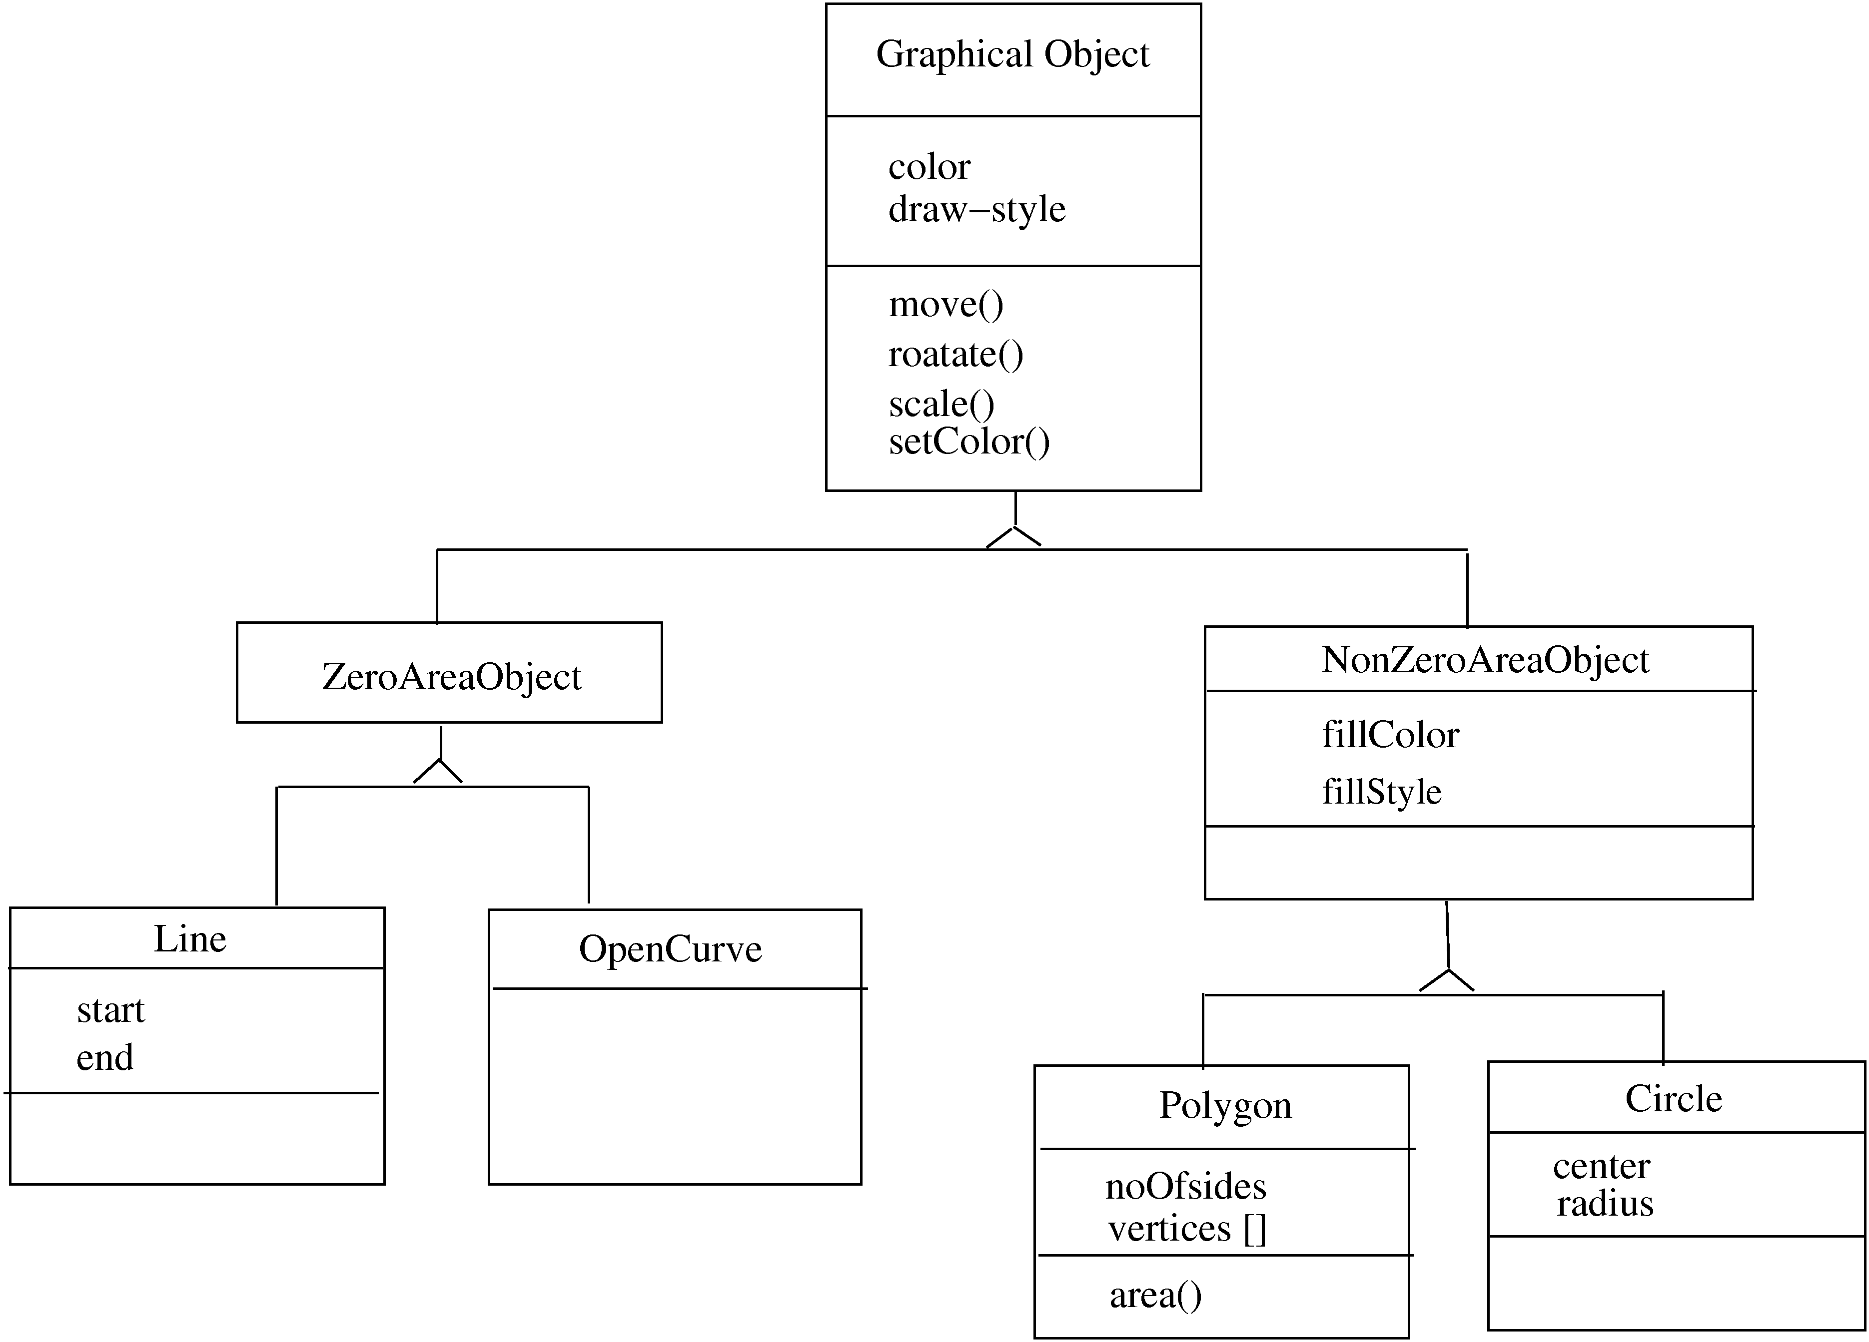

Slide 12
Inheritance…
Strict inheritance – a subclass takes all features of parent class
Only adds features to specialize it
Non-strict: when some of the features have been redefined
Strict inheritance supports “is-a” cleanly and has fewer side effects

Slide 13
Inheritance…
Single inheritance – a subclass inherits from only one superclass
Class hierarchy is a tree
Multiple inheritance – a class inherits from more than one class
Can cause runtime conflicts
Repeated inheritance - a class inherits from a class but from two separate paths

Slide 14
Inheritance and Polymorphism
Inheritance brings polymorphism, i.e. an object can be of different types
An object of type B is also an object of type A
Hence an object has a static type and a dynamic type
Implications on type checking
Also brings dynamic binding of operations which allows writing of general code where operations do different things depending on the type

Slide 15
Unified Modeling Language (UML) and Modeling
UML is a graphical notation useful for OO analysis and design
Allows representing various aspects of the system
Various notations are used to build different models for the system
OOAD methodologies use UML to represent the models they create

Slide 16
Modeling
Modeling is used in many disciplines – architecture, aircraft building, …
A model is a simplification of reality
“All models are wrong, some are useful”
A good model includes those elts that have broad effect and omits minor elts
A model of a system is not the system!

Slide 17
Why build models?
Models help us visualize a system
Help specify the system structure
Gives us a template that can guide the construction
Document the decisions taken and their rationale

Slide 18
Modeling
Every complex system requires multiple models, representing diff aspects
These models are related but can be studied in isolation
Eg. Arch view, electrical view, plumbing view of a building
Model can be structural, or behavioral

Slide 19
Views in an UML
A use case view
A design view
A process view
Implementation view
Deployment view
We will focus primarily on models for design – class diagram, interaction diagram, etc.

Slide 20
Class Diagrams
Classes are the basic building blocks of an OO system as classes are the implementation units also
Class diagram is the central piece in an OO design. It specifies
Classes in the system
Association between classes
Subtype, supertype relationship

Slide 21
Class Diagram…
Class itself represented as a box with name, attributes, and methods
There are conventions for naming
If a class is an interface, this can be specified by <<interface>> stereotype
Properties of attr/methods can be specified by tags between { }

Slide 22
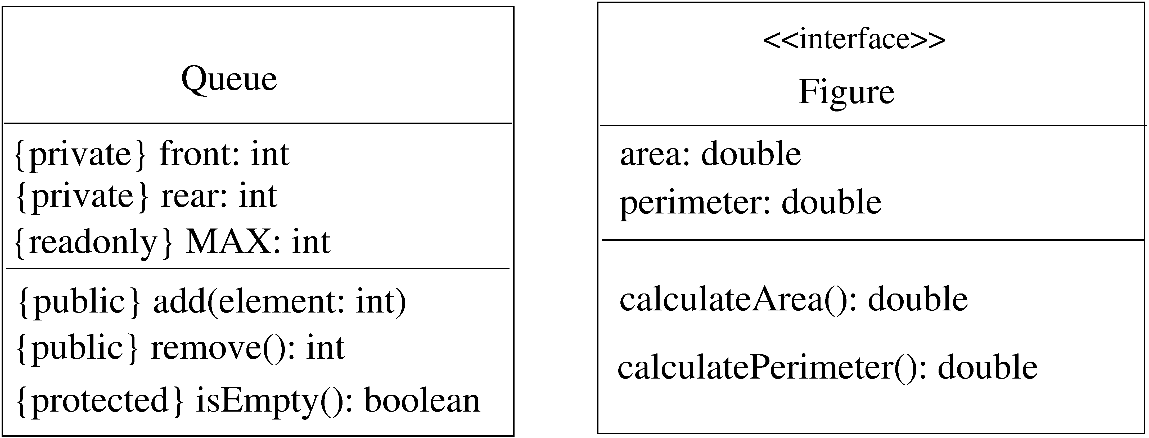
Class – example

Slide 23
Generalization-Specialization
This relationship leads to class hierarchy
Can be captured in a class diagram
Arrows coming from the subclass to the superclass with head touching super
Allows multiple subclasses
If specialization is done on the basis of some discriminator, arrow can be labeled

Slide 24
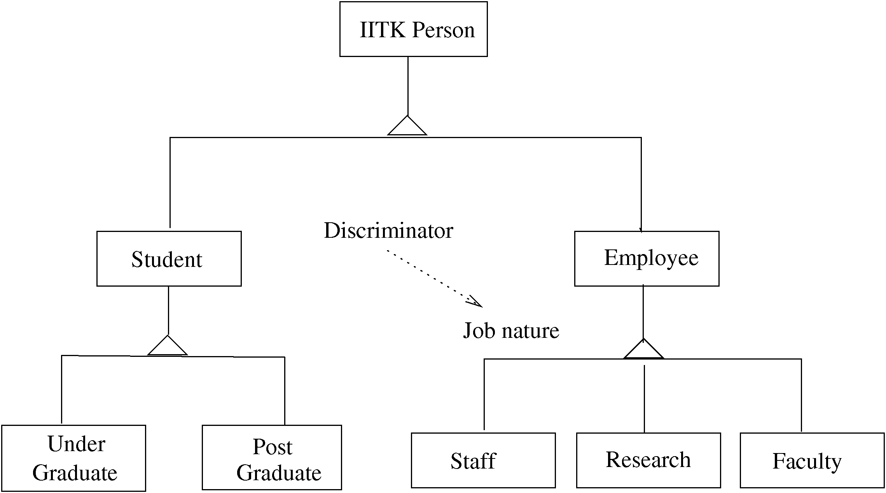
Example – class hierarchy

Slide 25
Association/aggregation
Classes have other relationships
Association: when objects of a class need services from other objects
Shown by a line joining classes
Multiplicity can be represented
Aggregation: when an object is composed of other objects
Captures part-whole relationship
Shown with a diamond connecting classes

Slide 26
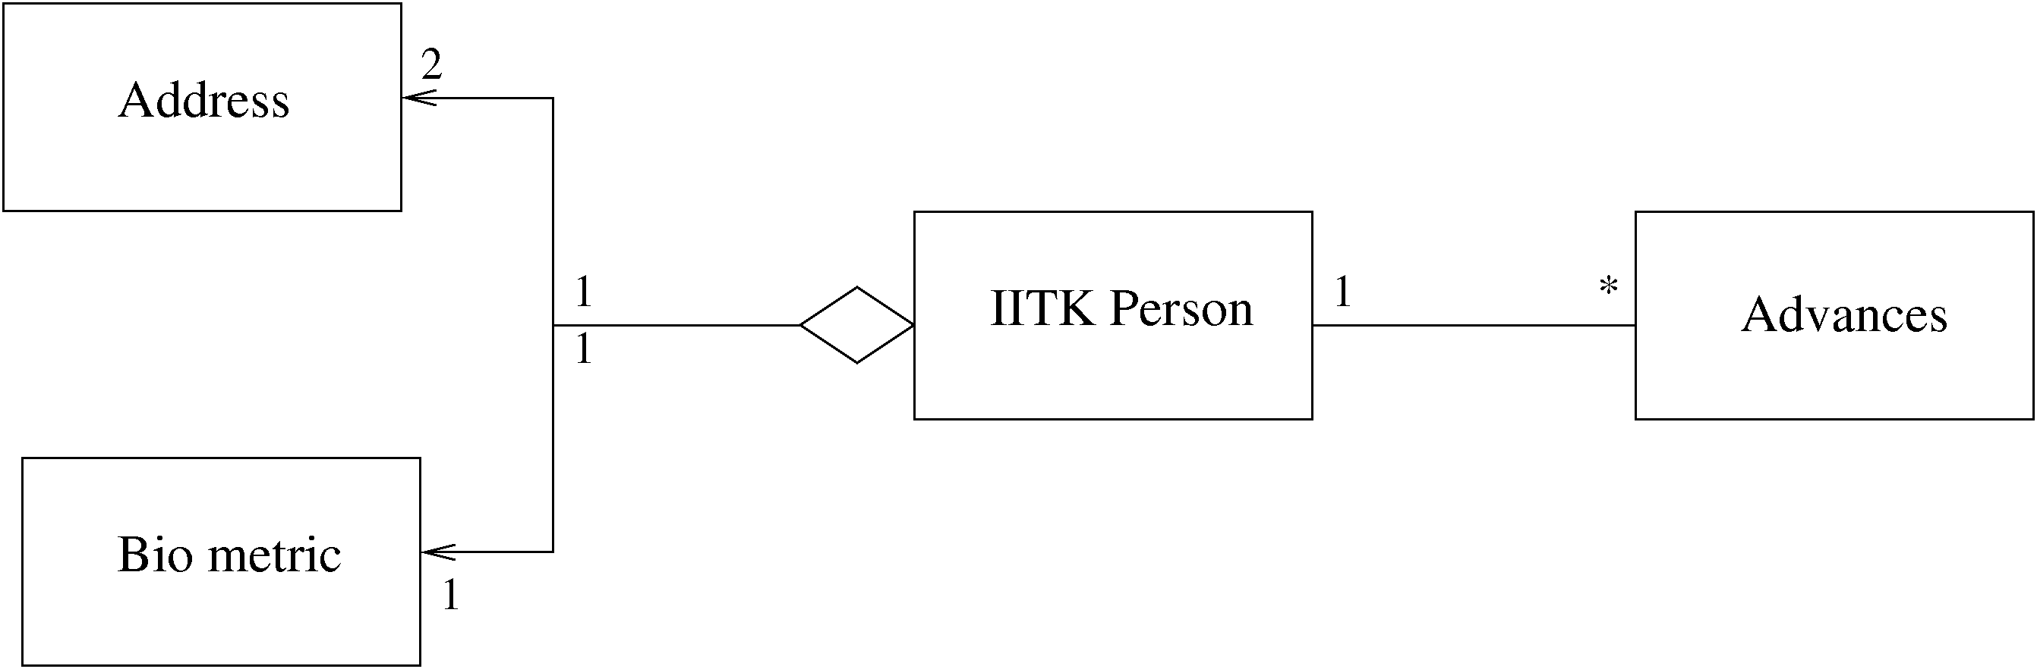
Example – association/aggregation

Slide 27
Interaction Diagrams
Class diagram represent static structure of the system (classes and their rel)
Do not model the behavior of system
Behavioral view – shows how objects interact for performing actions (typically a use case)
Interaction is between objects, not classes
Interaction diagram in two styles
Collaboration diagram
Sequence diagram
Two are equivalent in power

Slide 28
Sequence Diagram
Objects participating in an interaction are shown at the top
For each object a vertical bar represents its lifeline
Message from an object to another, represented as a labeled arrow
If message sent under some condition, it can be specified in bracket
Time increases downwards, ordering of events is captured

Slide 29
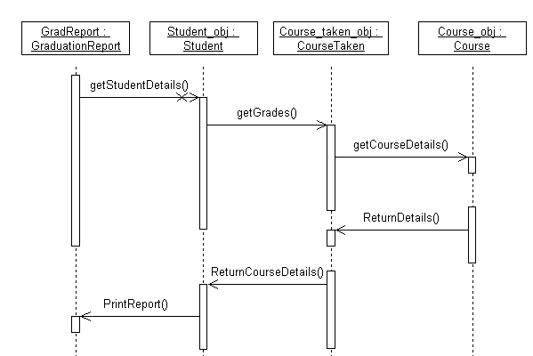
Example – sequence diag.

Slide 30
Collaboration diagram
Also shows how objects interact
Instead of timeline, this diagram looks more like a state diagram
Ordering of messages captured by numbering them
Is equivalent to sequence diagram in modeling power

Slide 31
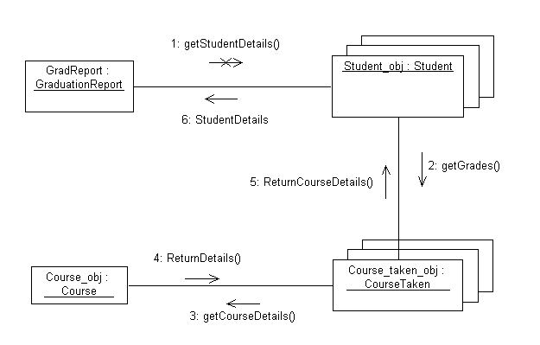
Example – collaboration diag

Slide 32
Other Diagrams
Class diagram and interaction diagrams most commonly used during design
There are other diagrams used to build different types of models

Slide 33
Other Diagrams
Instead of objects/classes, can represent components, packages, subsystems
These are useful for developing architecture structures
UML is extensible – can model a new but similar concept by using stereotypes (by adding <<name>>)
Tagged values can be used to specify additional properties, e.g. private, readonly..
Notes can be added

Slide 34
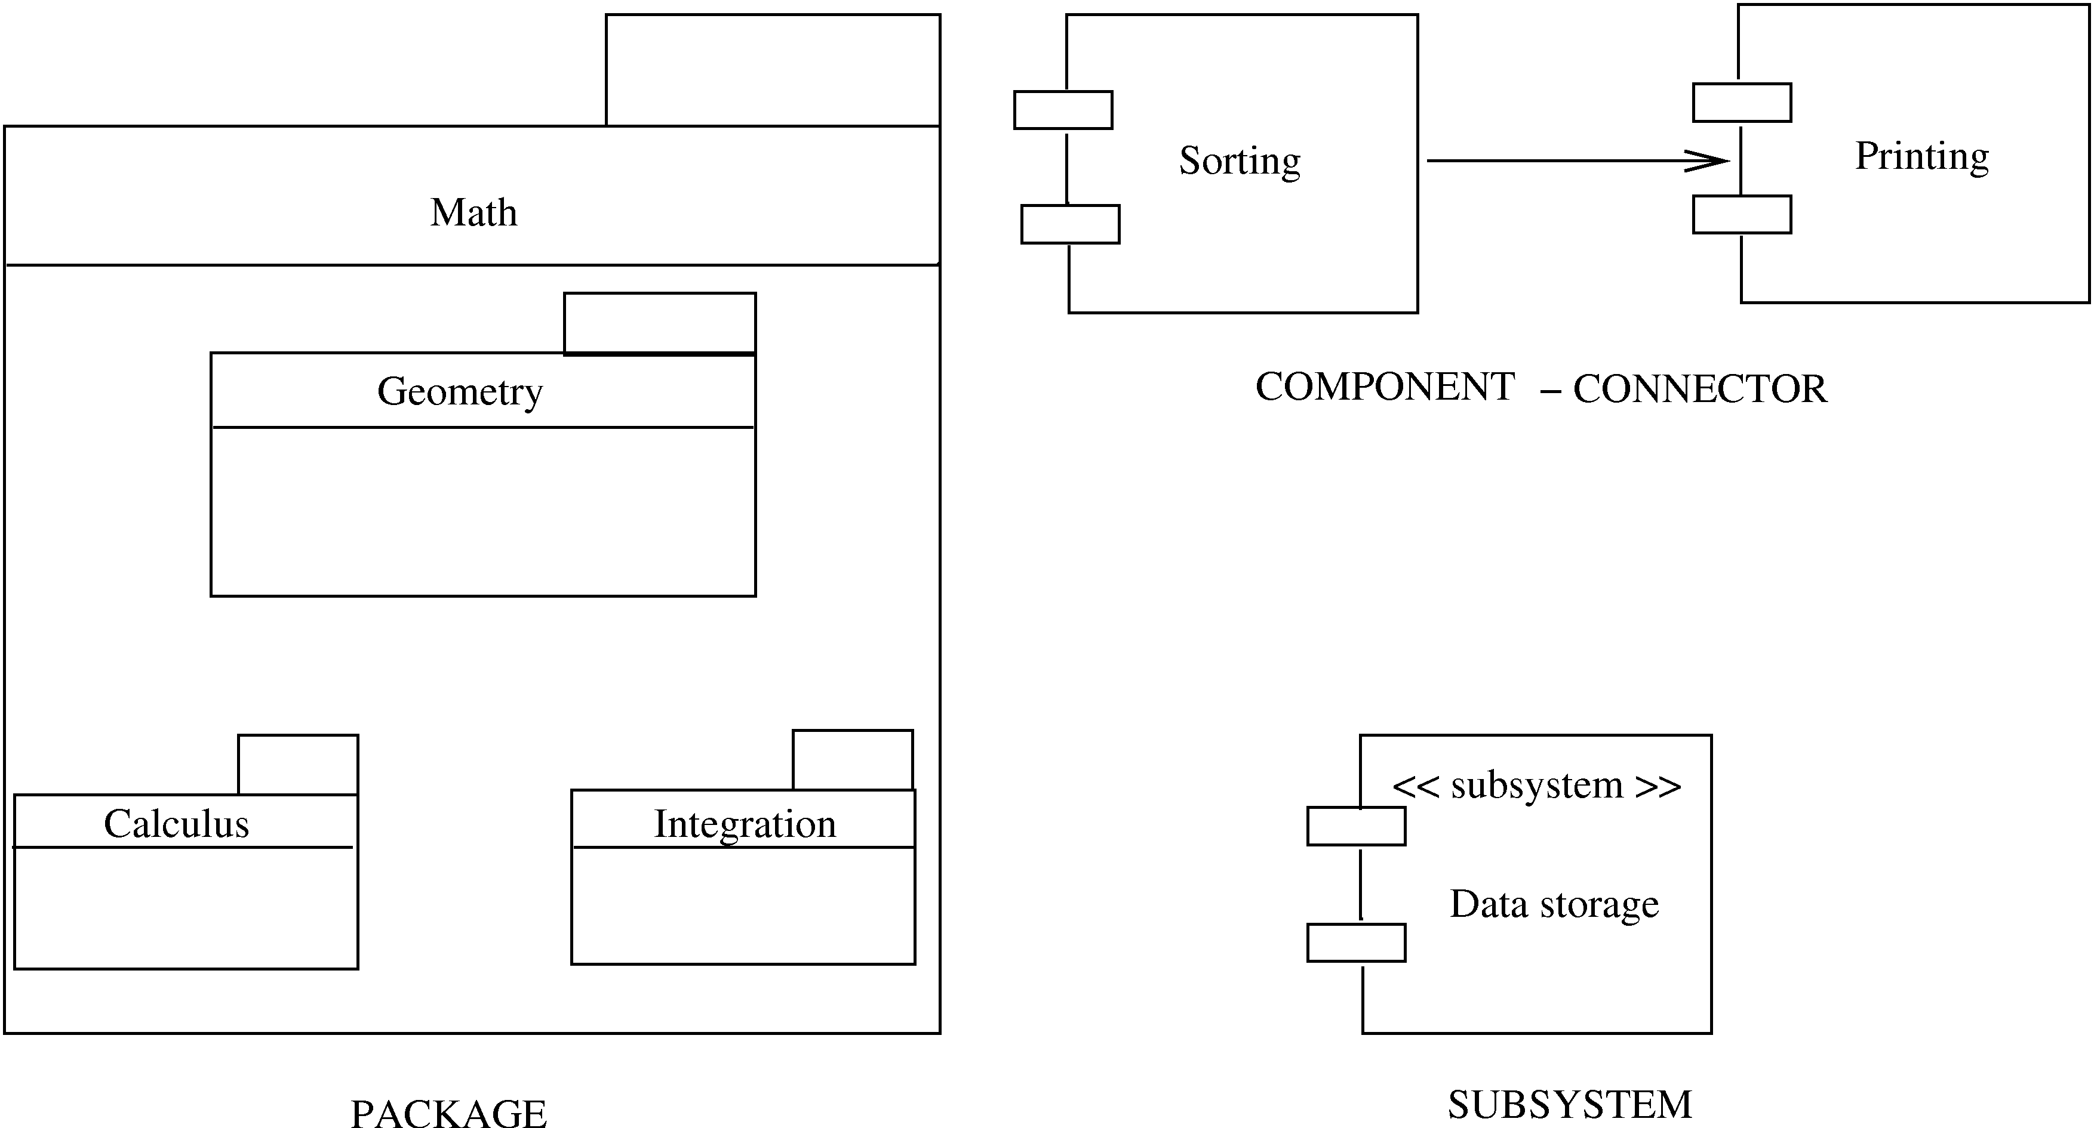
Other symbols

Slide 35
Design using UML
Many OOAD methodologies have been proposed
They provide some guidelines on the steps to be performed
Basic goal is to identify classes, understand their behavior, and relationships
Different UML models are used for this
Often UML is used, methodologies are not followed strictly

Slide 36
Design using UML
Basic steps
Identify classes, attributes, and operations from use cases
Define relationships between classes
Make dynamic models for key use cases and use them to refine class diagrams
Make a functional model and use it to refine the classes
Optimize and package
Class diagrams play the central role; class defn gets refined as we proceed

Slide 37
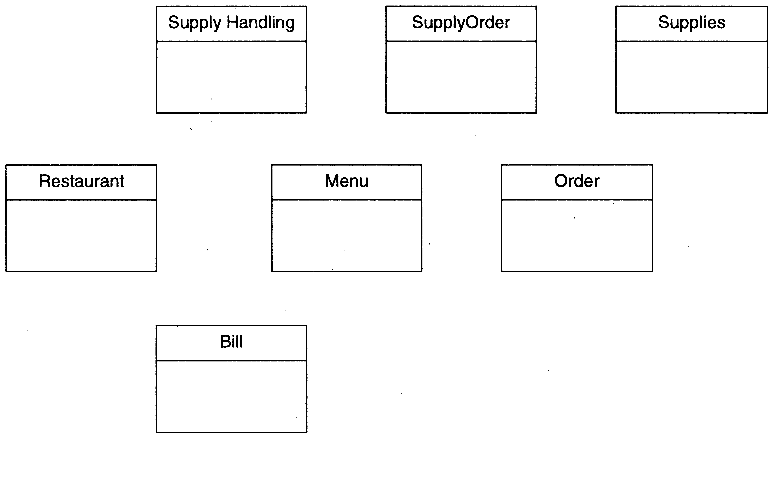
Restaurant example: Initial classes

Slide 38
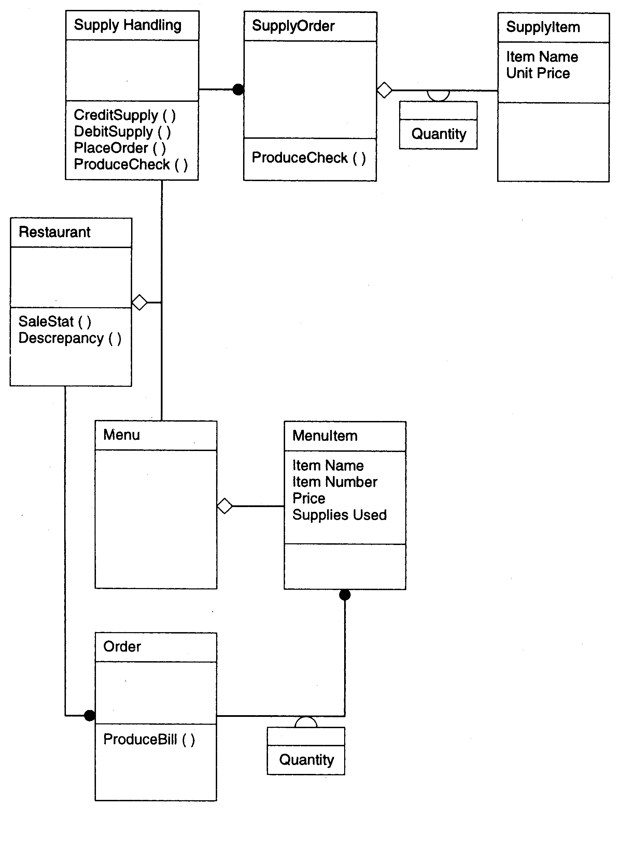

Slide 39
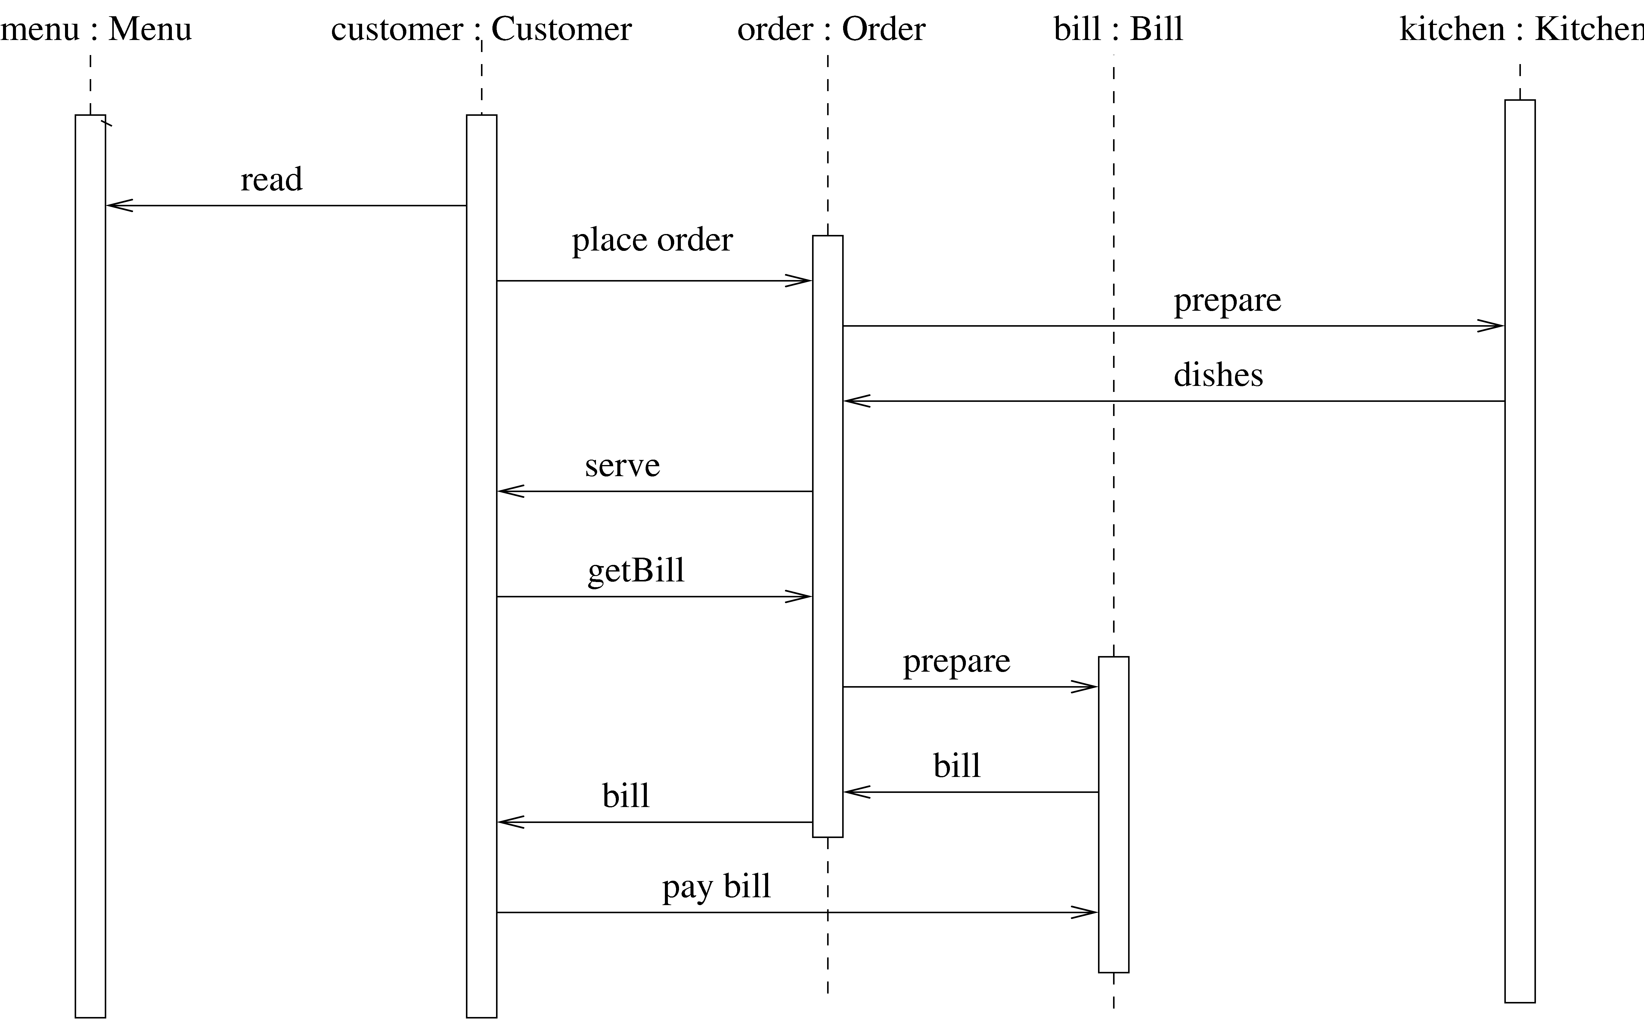
Restaurant example: a seq diag

Slide 40
Detailed Design
HLD does not specify module logic; this is done during detailed design
One way to communicate the logic design: use natural language
Is imprecise and can lead to misunderstanding
Other extreme is to use a formal language
Generally a semi-formal language is used – has formal outer structures but informal inside

Slide 41
Logic/Algorithm Design
Once the functional module (function or methods in a class) are specified, the algo to implement it is designed
Various techniques possible for designing algorithm – in algos course
Stepwise refinements technique is useful here

Slide 42
State Modeling of Classes
Dynamic model to represent behavior of an individual object or a system
Shows the states of an object and transitions between them
Helps understand the object – focus only on the important logical states
State diagrams can be very useful for automated and systematic testing

Slide 43
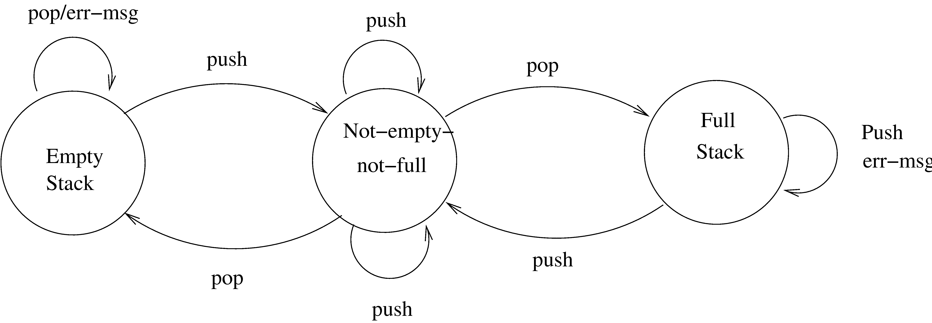
State diagram of a stack

Slide 44
Design Verification
Main objective: does the design implement the requirements
Analysis for performance, efficiency, etc may also be done
If formal languages used for design representation, tools can help
Design reviews remain the most common approach for verification

Slide 45
Metrics

Slide 46
Background
Basic purpose to provide a quantitative evaluation of the design (so the final product can be better)
Size is always a metric – after design it can be more accurately estimated
Number of modules and estimated size of each is one approach
Complexity is another metric of interest – will discuss a few metrics

Slide 47
Network Metrics
Focus on structure chart; a good SC is considered as one with each module having one caller (reduces coupling)
The more the SC deviates from a tree, the more impure it is Graph impurity = n – e – 1 n – nodes, e- edges in the graph
Impurity of 0 means tree; as this no increases, the impurity increases

Slide 48
Stability Metrics
Stability tries to capture the impact of a change on the design
Higher the stability, the better it is
Stability of a module – the number of assumptions made by other modules about this module
Depends on module interface, global data the module uses
Are known after design

Slide 49
Information Flow Metrics
Complexity of a module is viewed as depending on intra-module complexity
Intramodule estimated by module size and the information flowing
Size in LOC
Inflow – info flowing in the module
Outflow – info flowing out of the module
Dc = size * (inflow * outflow)²

Slide 50
Information flow metrics…
(inflow * outflow) represents total combination of inputs and outputs
Its square reps interconnection between the modules
Size represents the internal complexity of the module
Product represents the total complexity

Slide 51
Identifying error-prone modules
Uses avg complexity of modules and std dev to identify error prone and complex modules:
Error prone: If Dc > avg complexity + std_dev
Complex: If avg complexity < Dc < avg + std dev
Normal: Otherwise

Slide 52
Complexity metrics for OO
Weighted methods per class
Complexity of a class depends on no of classes and their complexity
Suppose complexity of methods is c1, c2..; by some functional complexity metric WMC = Σ ci
Large WMC might mean that the class is more fault-prone

Slide 53
OO Metrics…
Depth of Inheritance Tree
DIT of C is depth from the root class
Length of the path from root to C
DIT is significant in predicting fault proneness
Number of Children
Immediate no of subclasses of C
Gives a sense of reuse

Slide 54
OO Metrics…
Coupling between classes
No of classes to which this class is coupled
Two classes are coupled if methods of one use methods or attr of other
Can be determined from code
(There are indirect forms of coupling that cannot be statically determined)

Slide 55
Metrics…
Response for a class
The total no of methods that can be invoked from this class
Captures the strength of connections
Lack of cohesion in methods
Two methods form a cohesive pair if they access some common vars (form a non-cohesive pair if no common var)
LCOM is the number of method pairs that are non-cohesive – the no of cohesive pairs

Slide 56
Metrics with detailed design
When logic is known, internal complexity metrics can be determined
We will cover all detailed design based metrics along with code metrics

Slide 57
Summary
Design for a system is a plan for a solution – want correct and modular
Cohesion and coupling key concepts to ensure modularity
Structure charts and structured design methodology can be used for function-oriented design
UML can be used for OO design
Various complexity metrics exist to evaluate a design complexity

